Slide 1
Machine Learning - Deployment
Anita Ramachandran
March 2024

Slide 2
Agenda
Model engineering
Model standardization
Model compression
Recent topics

Slide 3
Model Engineering
ML/AI is rapidly adopted by new applications and industries!
Goal of a machine learning project is to build a statistical model by using collected data and applying machine learning algorithms
  Yet building successful ML-based software projects is still difficult
Every ML-based software needs to manage three main assets:
  Data
  Model
  and Code
Essential technical methodologies - involved in the development of the Machine Learning-based software
  Data Engineering: data acquisition & data preparation,
  ML Model Engineering: ML model training & serving, and
  Code Engineering : integrating ML model into the final product.

Slide 4
Model Engineering
Phase of writing and executing machine learning algorithms to obtain an ML model
The Model Engineering pipeline includes a number of operations that lead to a final model:
  Model Training
    The process of applying the machine learning algorithm on training data to train an ML model
    includes feature engineering and the hyperparameter tuning for the model training activity
  Model Evaluation
    Validating the trained model to ensure it meets original codified objectives before serving the ML model in production to the end-user
  Model Testing
    Performing the final “Model Acceptance Test” by using the hold backtest dataset
  Model Packaging
    The process of exporting the final ML model into a specific format
    which describes the model, in order to be consumed by the business application

Slide 5
Model Deployment
Need to deploy model as part of a business application such as a mobile or desktop application
  The ML models require various data points (feature vector) to produce predictions
  The final stage of the ML workflow is the integration of the previously engineered ML model into existing software
Includes the following operations:
  Model Serving
    The process of addressing the ML model artifact in a production environment
  Model Performance Monitoring
    The process of observing the ML model performance based on live and previously unseen data, such as prediction or recommendation
    interested in ML-specific signals, such as prediction deviation from previous model performance
    signals might be used as triggers for model re-training
  Model Performance Logging
    Every inference request results in the log-record

Slide 6
Model Deployment
Need for focus on deployment
Options
  Deploying machine learning models as web services
    Persist models, serve them up using REST APIs (e.g. using Flask)
  Deploying machine learning models for batch prediction
  Deploying machine learning models on edge devices as embedded models
    Reduced latency, reduced data bandwidth consumption
    Model compression
    Tflite
Ref: https://towardsdatascience.com/3-ways-to-deploy-machine-learning-models-in-production-cdba15b00e

Slide 7
ML deployment techniques
Key components of model monitoring

Slide 8
Steps in Operationalizing ML Models

Slide 9
Model Engineering
Machine learning pipelines vs classical software engineering pipelines
MLOps
  Comparison with DevOps
  MLOps tools and pipelines
  Pipeline orchestration
AutoML
  Hyperparameter tuning
  AutoML frameworks

Slide 10
ML Workflows
ML architecture patterns
Model serving patterns

Slide 11
Model Serving Strategies
Common ways for wrapping trained models as deployable services, namely deploying ML models as
  Docker Containers to Cloud Instances
  Serverless Functions

Slide 12
Agenda
Model engineering
Model standardization
Model compression
Recent topics

Slide 13
Model standardization
Why is model serving difficult?
  Data scientists and software engineers: two groups with different goals
  Tool proliferation
Model representation standards
  Similar to WSDL in the web server world
  PMML and PFA from the Data Mining group
Support from development libraries
  TensorFlow allows to export models in text & binary for transferring models between machine learning and model serving
  ONNX
    An open format to represent ML models
    Allows using one tool stack for model training and another for inferencing
    Enables framework interoperability to prevent framework lock-in

Slide 14
Agenda
Model engineering
Model standardization
Model compression
Recent topics

Slide 15
Model Compression
Resource constrained environments
Resource requirements for hosting ML models
Model compression techniques
  Parameter pruning and quantization, low rank factorization, transferred/compact convolutional filters, knowledge distillation
TinyML
  TFLite, GLOW, PyTorch Mobile, Edge Impulse, AIfES
Architectural considerations
  Tradeoffs – latency, accuracy, compute requirements, power consumption

Slide 16
Agenda
Model engineering
Model standardization
Model compression
Recent topics
  Data Privacy for Machine Learning
  Distributed Machine Learning
  Federated Machine Learning

Slide 17
Data Privacy for Machine Learning
Data privacy issues
  What is private and what is not; Who do we want to keep data private from; Who are the trusted parties
  Protection of Personally identifying information (PII), sensitive data, quasi-identifying data
  Should users who provide less data receive less accurate predictions than the users who contribute more data
Methods to help increase privacy
  Differential Privacy (Local DP, Global DP)
    Federated learning system
    Private Aggregation of Teacher Ensembles (PATE) approach
    TensorFlow Privacy
  Encrypted Machine Learning
    Homomorphic encryption (HE) and Secure Multiparty Computation (SMPC)

Slide 18
Agenda
Model engineering
Model standardization
Model compression
Recent topics
  Data Privacy for Machine Learning
  Distributed Machine Learning
  Federated Machine Learning

Slide 19
Distributed Machine Learning
Multinode machine learning algorithms and systems that are designed to improve performance, increase accuracy, and scale to larger input data sizes
Data parallelism
  Data is split across devices; each node trains on a subset of data
Model parallelism
  Model is split across devices; each node trains on the complete dataset

Slide 20
Agenda
Model engineering
Model standardization
Model compression
Recent topics
  Data Privacy for Machine Learning
  Distributed Machine Learning
  Federated Machine Learning

Slide 21
Federated Machine Learning
A protocol where the training of a machine learning model is distributed across many different devices and the trained model is combined on a central server
Model training
Secure aggregation of weights into the central model
DP limits the amount of information that each user can contribute to the final model

Slide 22
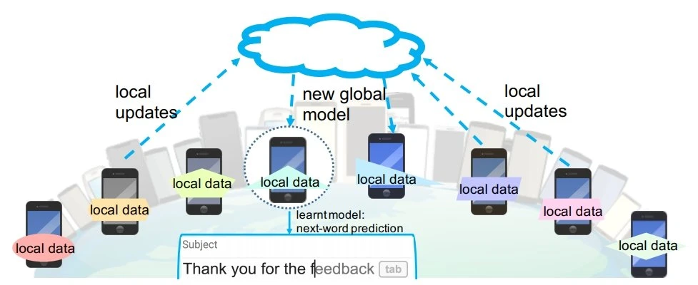
Federated Machine Learning
Source: https://viso.ai/deep-learning/federated-learning/
Challenges
  Not all data sources may have collected new data between one training run and the next
  Not all mobile devices are powered on all the time
  Performance issues on devices that train an FL model
  Requires frequent communication across the nodes in the federated network
  Workflows

Slide 23
Federated Learning vs Distributed Learning
FL does not allow direct raw data communication. DL does not have any such restriction.
FL employs the distributed computing resources in multiple regions or organisations. DL utilises a single server or a cluster in a single region, which belongs to a single organisation.
FL generally takes advantage of encryption or other defence techniques to ensure data privacy or security. FL promises to safeguard the confidentiality and security of the raw data. There is less focus on safety in DL.

Slide 24
Applications
TinyML
  Industrial Predictive Maintenance, Healthcare, Agriculture, Ocean life conservation
Federated Learning
  Useful in the context of mobile phones with distributed data, or a user’s browser
  Sharing of sensitive data that is distributed across multiple data owners
  An example of FL in production is Google’s Gboard keyboard for Android mobile phones

